Slide 1


Case Study:
Student Score Prediction
Project Link:
Student-Score-Prediction-Project
Student names:
Prasad Khanapure
Pratik Manjarekar
Pratik Londhe
Mohak Nale
Ketan Kaiwart

Slide 2
Problem Statement
Brief Overview:
This study aims to predict the score a student might achieve based on the number of hours they studied. By analyzing this relationship, we can provide data-driven insights to help students optimize their study strategies for better academic performance.
Real-Life Example: The study-hours-to-performance prediction model is already being used in education, corporate training, and exam preparation tools to improve learning outcomes. This concept can be scaled further to build smart, AI-powered study assistants that help students optimize their learning time effectively.
Source :
www.freepik.com/

Slide 3
Key Objectives:
1. Predict Student Performance
-Develop a model to estimate a student’s score based on the number of hours studied.
-Provide an early indication of potential outcomes.
2. Understand the Relationship Between Study Time and Scores
-Identify whether there is a strong correlation between study hours and performance.
-Determine if additional factors (e.g., sleep, study techniques) should be considered.
3. Optimize Study Strategies
-Help students plan their study time effectively.
-Provide recommendations on the ideal number of study hours for better performance.
4. Support Educational Decision-Making
-Assist educators in identifying students who may need extra support.
-Help institutions design study plans based on data-driven insights.
5. Improve Personalized Learning
-Allow adaptive learning platforms to suggest study hours for different students.
-Use predictive models to provide customized recommendations.
.
Source :
www.freepik.com/

Slide 4
Dataset Overview :
1.*Dataset Structure*:
The dataset is organized in a tabular format, where each row corresponds to an individual student and each column represents specific attributes related to their study habits and academic performance.
2.*Data Collection*: -
Data collection for predicting student scores typically involves gathering various factors such as study hours, previous exam scores, and demographic information. Techniques like regression analysis are commonly used to model the relationship between these variables and forecast future academic performance.
3.*learning*: -
Learning styles refer to the preferred ways in which individuals absorb, process, and retain information. Understanding different learning styles can help educators tailor their teaching methods to better meet the needs of their students, ultimately enhancing academic performance
4.*sample*: -
| Student ID | Study Hours | Score | Subject |
Sources :
Students Score Dataset - Linear Regression - Kaggle
Source :
www.freepik.com/

Slide 5
Methodology
1. Data Collection
Gather data on students’ study hours and corresponding exam scores.
Data can be collected from past academic records, surveys, or experiments.
Ensure the dataset is diverse and unbiased.
2. Data Preprocessing
Cleaning Data: Handle missing or incorrect values.
Exploratory Data Analysis (EDA): Use visualizations (scatter plots, histograms) to understand trends.
Feature Engineering: Select relevant variables (e.g., study hours, sleep patterns, previous scores).
3. Model Selection
Simple Linear Regression: If using study hours as the only predictor.
Multiple Linear Regression: If adding other factors like past performance or sleep duration.
Machine Learning Algorithms: If a more complex pattern needs to be captured (e.g., Decision Trees, Neural Networks).
Source :
www.freepik.com/

Slide 6
4. Model Training & Evaluation
Split data into training and testing sets (e.g., 80% training, 20% testing).
Train the model using appropriate regression techniques.
5. *Model Evaluation* - *Performance Metrics*: Evaluate model performance using metrics such as Mean Absolute Error (MAE), Mean Squared Error (MSE), R-squared, and others. - *Validation*: Validate the model with the testing dataset to ensure it generalizes well to unseen data.
6. *Prediction and Analysis* - *Make Predictions*: Use the trained model to make predictions on air quality levels for future timeframes. - *Scenario Analysis*: Analyze the impact of different variables (e.g., increased traffic, weather changes) on air quality predictions.
Algorithms Used:
1. *Linear Regression* : - A statistical method that models the relationship between independent variables and the dependent variable . - *Use Case*: Suitable for understanding linear relationships and making simple predictions.
Source :
www.freepik.com/

Slide 7
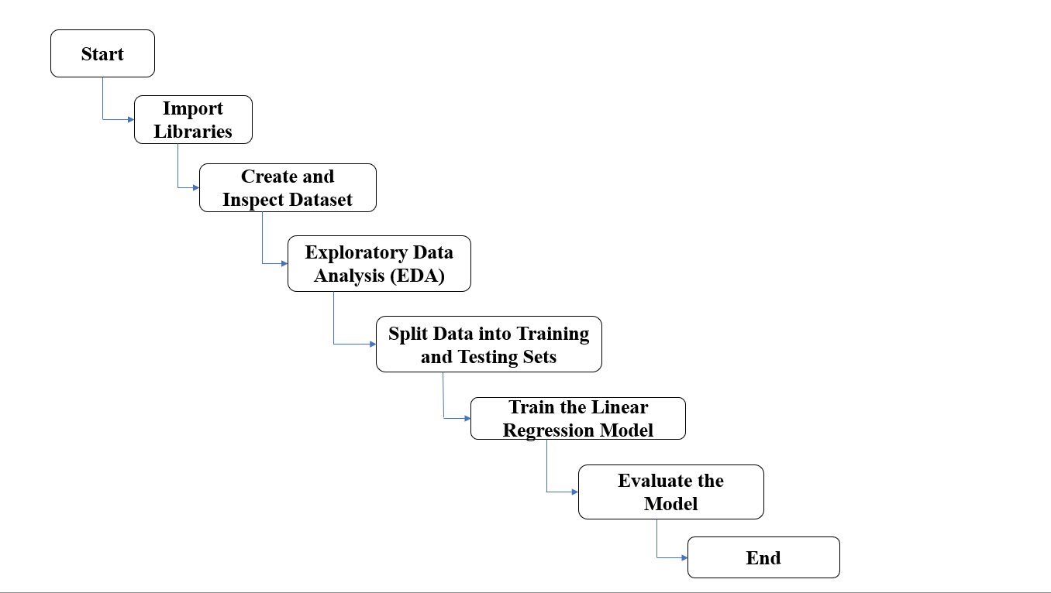
Flow Chart:
Fig : Air Quality Prediction Model
Source :
www.freepik.com/

Slide 8

Conclusion
Predicting student scores based on study hours is a multifaceted endeavor that integrates various factors, including study habits, learning styles, and environmental influences such as meteorological data. By employing a structured methodology for data collection and analysis, educators and researchers can gain valuable insights into the relationship between study time and academic performance.
Future Work:
As the field of educational data analysis continues to evolve, there are several avenues for future work that can enhance the understanding and prediction of student scores based on study hours
Source :
www.freepik.com/

Slide 9
References
### Books
1 Data Science for Education:
“How to Use Data to Improve Student Learning" by David A. McMurtrie
2 Learning Styles:
“Concepts and Evidence” by Harold Pashler, Mark McDaniel, Doug Rohrer, and Robert Bjork
###Research Papers
1.Predicting Student Performance:
“A Review of the Literature" by A. A. Almarashdeh, A. A. Alsharif, and A. A. Alzahrani
2.The Impact of Study Habits on Academic Performance:
“A Study of Students in Higher Education” by A. A. A. A. Alzahrani

Slide 10
Thank You
Notes:
Thank You !!

